Slide 1
Lecture 2 3D Modeling and Animation Assoc.Prof.Dr. Hossam Mahmoud Moftah Associate professor – Faculty of computers and artificial intelligence– Beni-Suef University

Slide 2
Chapter 2 Getting to Know the Production Pipeline
Understanding the production pipeline’s components
Working in preproduction
Working in production
Working in postproduction
Using production tools
Adapted from Andy Beane: 3D animation essentials 2012 by John Wiley & Sons, Inc.,

Slide 3
Understanding the production pipeline’s components
A 3D animation production pipeline is composed of three components :
people,
hardware,
software
Adapted from Andy Beane: 3D animation essentials 2012 by John Wiley & Sons, Inc.,

Slide 4
Stages of the production pipeline
The three main stages of the production pipeline are as follows:
Preproduction
Production
Postproduction
Adapted from Andy Beane: 3D animation essentials 2012 by John Wiley & Sons, Inc.,

Slide 5
Working in preproduction
Preproduction is the planning, designing, and research phase of the entire 3D Project
The preproduction stage is divided into five components:
Idea/story
Script/screenplay
Storyboards
Animatic/pre-visualization
Design
The typical order of these components is as above
Adapted from Andy Beane: 3D animation essentials 2012 by John Wiley & Sons, Inc.,

Slide 6
Idea/story
An idea can be sparked by a single word, a sentence, a color, a smell, a sound, passing conversations with a stranger, or eavesdropping on someone
The following are some questions to ask yourself during this idea/story component:
Who are the characters?
What is this project for?
Who is your audience?
What is the conflict?
What is the final product?
Who will want to use my idea?
Who will want to buy my idea?
What is the payoff for my audience?
If you can answer these questions, you are ready to move a step forward in the production pipeline.
Adapted from Andy Beane: 3D animation essentials 2012 by John Wiley & Sons, Inc.,

Slide 7
Script/Screenplay
The script or screenplay is the formal written form of the final story.
It has written within it the following components:
basic character movements,
environment,
time,
actions,
dialogue.
The typical length of a script depends on the type of project.
A feature-film script is about 100 to 120 pages in length.
A 30-minute TV-episode script is about 15 to 22 pages.
Adapted from Andy Beane: 3D animation essentials 2012 by John Wiley & Sons, Inc.,

Slide 8
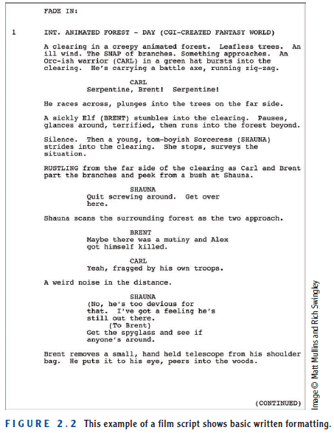
Script/Screenplay
Adapted from Andy Beane: 3D animation essentials 2012 by John Wiley & Sons, Inc.,

Slide 9
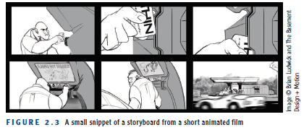
Storyboard
The storyboard is the visual story form of the script/screenplay.
A storyboard is also the first visual representation of your entire story.
Many animators skip the script/screenplay stage because of their lack of training in formal writing and use the storyboard as the script.
There is a saying that a picture is worth a thousand words
Adapted from Andy Beane: 3D animation essentials 2012 by John Wiley & Sons, Inc.,

Slide 10
Animatic/Pre-visualization
An animatic is a moving form of the storyboard.
If you think of a storyboard as a comic book, an animatic is a limited animation of your entire story.
It is, in its most simple form, just the storyboard images timed out to temporary dialogue and simple sound effects, to show the sequence pacing of the project.
Because the amount of 3D animation or 3D visual effects that go into these types of films and television shows is expensive
Adapted from Andy Beane: 3D animation essentials 2012 by John Wiley & Sons, Inc.,

Slide 11
Design
In the design component, the final look of the project is decided.
For the entertainment industries, this includes the character design, prop design, costumes, and environment designs.
Adapted from Andy Beane: 3D animation essentials 2012 by John Wiley & Sons, Inc.,

Slide 12
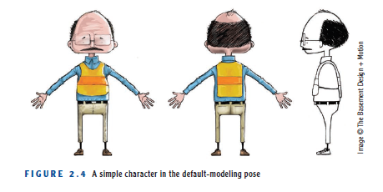
Design
Adapted from Andy Beane: 3D animation essentials 2012 by John Wiley & Sons, Inc.,

Slide 13
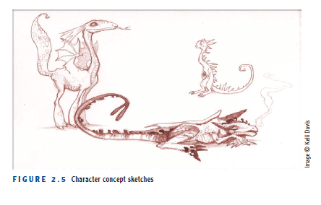
Design
Adapted from Andy Beane: 3D animation essentials 2012 by John Wiley & Sons, Inc.,

Slide 14
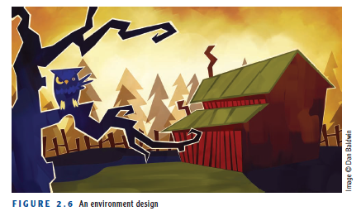
Design
Adapted from Andy Beane: 3D animation essentials 2012 by John Wiley & Sons, Inc.,

Slide 15
Working in Production
The production stage includes the following components:
Layout
Research and development (R&D)
Modeling
Texturing
Rigging/setup
Animation
3D visual effects (VFX)
Lighting/rendering
Adapted from Andy Beane: 3D animation essentials 2012 by John Wiley & Sons, Inc.,

Slide 16
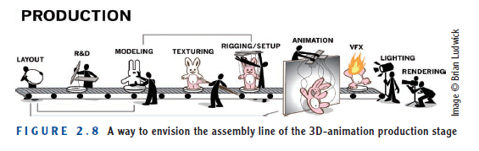
Working in Production
Adapted from Andy Beane: 3D animation essentials 2012 by John Wiley & Sons, Inc.,

Slide 17
Layout
In the 3D layout stage, you create a 3D version of the animatic.
In 3D, it is sometimes difficult to cheat perspective angles, scale of characters to camera, or the distance objects are from one another .
3D layout should begin as soon as you have created proxy geometry—low-resolution representations of your final models.
For the 3D layout, the proxy models do not need extra attributes such as a face or even fingers to describe the visual story.
Adapted from Andy Beane: 3D animation essentials 2012 by John Wiley & Sons, Inc.,

Slide 18
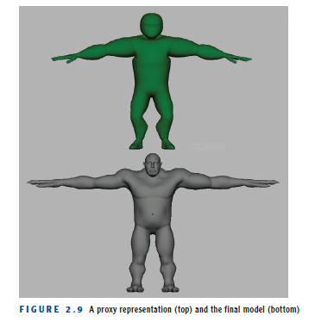
Layout
Adapted from Andy Beane: 3D animation essentials 2012 by John Wiley & Sons, Inc.,

Slide 19
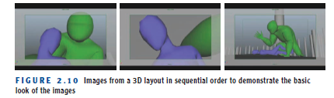
Layout
Adapted from Andy Beane: 3D animation essentials 2012 by John Wiley & Sons, Inc.,

Slide 20
Research and development (R&D)
In R&D, a team of artists from many different components work with technical directors on upcoming technical challenges in the project.
For example, in Pixar’s Finding Nemo, the R&D team had to figure out how to create the look of water, including the little floaty things in the water.
Adapted from Andy Beane: 3D animation essentials 2012 by John Wiley & Sons, Inc.,

Slide 21
Modeling
A model is a geometric surface representation of an object that can be rotated and viewed in a 3D-animation software package.
There are many techniques for creating 3D models:
Using a 3D-animation software package such as Autodesk’s Maya, 3ds Max, or Softimage.
Using a laser scanner technology to scan a real object and create a digital 3D representation of that object.
You can digitally sculpt your object as if it were clay in software packages such as Autodesk’s Mudbox or Pixologic’s ZBrush.
Adapted from Andy Beane: 3D animation essentials 2012 by John Wiley & Sons, Inc.,

Slide 22
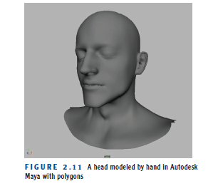
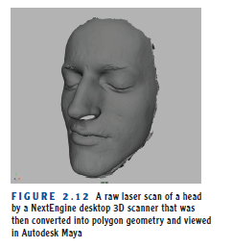
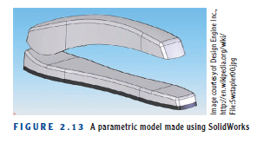
Modeling
video scanning
Adapted from Andy Beane: 3D animation essentials 2012 by John Wiley & Sons, Inc.,

Slide 23
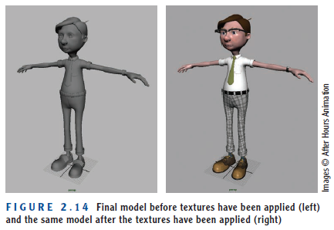
Texturing
In the texturing component, texture artists apply color and surface properties to the geometric models.
The models generally come to the texture artist in a program’s default shaded flat color.
Adapted from Andy Beane: 3D animation essentials 2012 by John Wiley & Sons, Inc.,

Slide 24
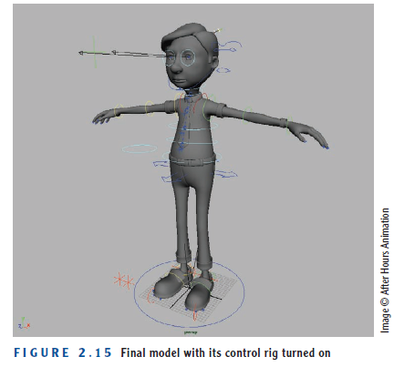
Rigging/Setup
Rigging is the component of the production pipeline during which a control rig is put into a geometric object so the animators can move that object.
video rigging
Adapted from Andy Beane: 3D animation essentials 2012 by John Wiley & Sons, Inc.,

Slide 25
Animation
In the animation component, the movement of objects or characters is created.
The animators take the layout file as a starting point to get the characters, set, and camera into a scene and then add the final performance or movement.
Adapted from Andy Beane: 3D animation essentials 2012 by John Wiley & Sons, Inc.,

Slide 26
3D Visual Effects
The 3D visual effects (VFX) artist animates everything but the characters or props the characters interact with .
For example, fur, hair, cloth, fire, water, and dust, to name just a few.
Adapted from Andy Beane: 3D animation essentials 2012 by John Wiley & Sons, Inc.,

Slide 27
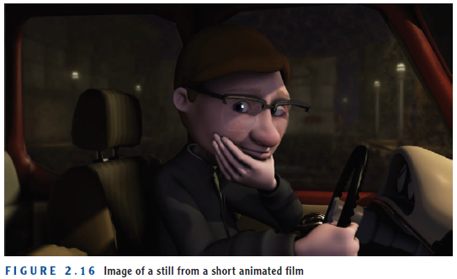
Lighting/Rendering
Lighting is the painting component of the production stage.
The lighting artists look at the color guides from the preproduction stage and create the lighting and mood for a scene or sequence.
Adapted from Andy Beane: 3D animation essentials 2012 by John Wiley & Sons, Inc.,

Slide 28
The End

